Slide 1
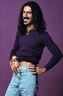
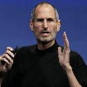

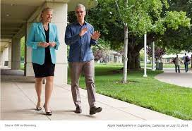
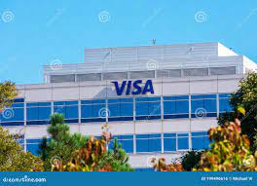
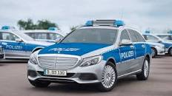
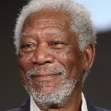
FBI
develoment
Food
Computer
3Hhrs
0.1 game ober
3hrs
Food
Computer
Black
Glu hr avg. ueber
Douglass Exit
A hobo is soemonw who sleeps outsie and weats bad clothes
WW2 arbeit macht frei
WW2 Wieland, Thomas
Paul glu fag
FBI:WMD for School shooter
2014.ATOCLOCK.CPVA.SQ.
(Facebook, drive to visa to see black logo)
AppDyanics
GOD.TERMAIN.JOEHPE(fuegesson)
.CHEKCPONCHELI(micheal)
Ancible
Ueber
GOD.TERMAIN.JOEHPE(fuegesson)
.CHEKCPONCHELI(micheal)
Ueber Eats
Github
41.Git commit

Slide 2
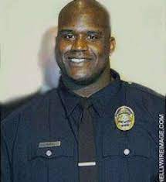
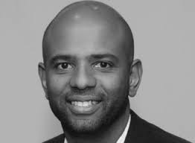
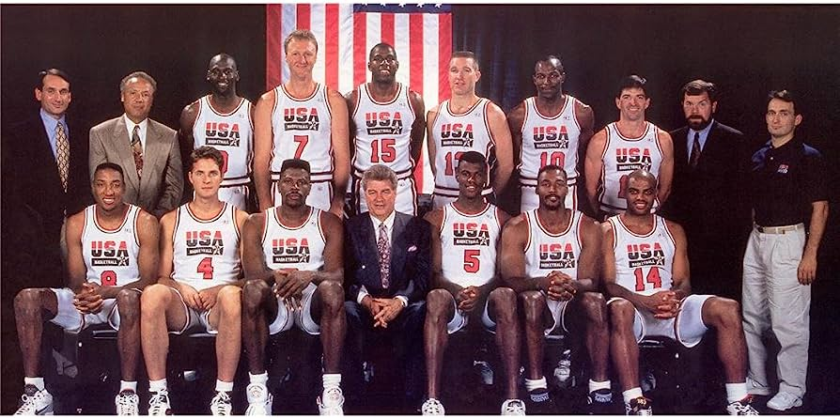
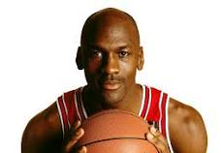
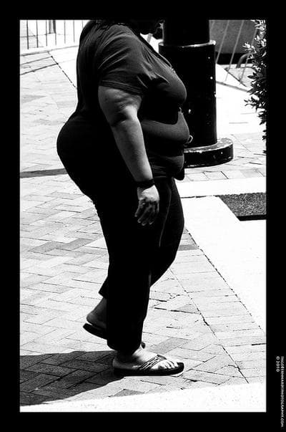
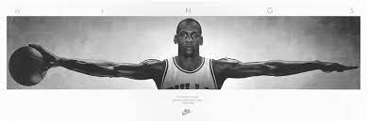
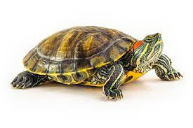

FBI
develoment
SQ.FEDERAL COURT(BILLBOAR)
NAME CHANGE(freee pizza, jim)
Ibm-dns: touchurban.com
$6000 personal CAPEX
JIM ADLER
Jodon:
Other:
AVAIBLITY.CPVA.gorbache(Jordo/an)
PENTONA.BASE.PAUL.LOVELLACE
Jodon:
O not A
JORDON
Nina
Winer: callig Jordon
Guy next door, motocy chrimatree
insteam
MATHEW:
AAA Radio Cabote
AAA better business buero
Adler, Andreas, Jim
touch
black dildo
Rich: ATOMCOCK(Gary),ATOMCL(tim)
IBM:SYSE: Billboard, Ralph Eusta, put billboard
Ibm Jamie, 30,000 put billboad
app brokers
Fag, nappyhair
Othe: SQ.call you rice (billboard).FATHER(JOEHPSE).St.RITA(prision)
LARRY: page,sergay ( peranl CAP EX $6,000).merkel.avg

Slide 3
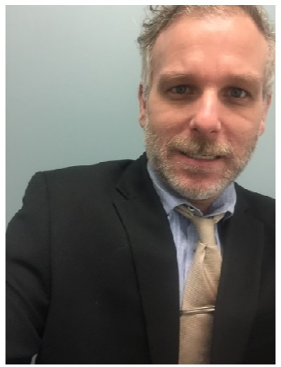
FBI
develoment
Jordon

Slide 4
FBI
develoment
AFFIMATIVE ACTION
DIVERISTY
Bacptish Chruch
Spahish Chruch
Indian Calthough Chruch – 0.1 nonPolcieCfg(VISITOR) 41.CIVIL CODE
American Chruch
German Church
!chine church
!gay chruch
I Don’t talk at work, 200 blak peop at shelter; at night

Slide 5
FBI
development
nonPoliceProcessLogical: Where and What? And If?
Stephone: studying, everyone statys up until 12pm
Jogging: 12pm – 1 am
MONDAY 8-4 Law Library
TUESDAY 8-4 Law Library
WEDNESDAY 8-4 Law Library
THRUSDAY 8-4 Law Library
FRIDAY 8-4 Law Library
SATURDAY 7am-9am Church
10am-6pm Library
SUNDAY 6am-7pm Church
1am-1:30/2am Walking to CIVIL COURT, JUSTICE CENTER
2am -5am ( 3 hour avg), 1 hour avg Public Security Green
Commercial Property or Public
Daily, Visual
Edison, FORT MYERS
3 Hours (sleep)
TRAIL MEMROIAL
CIVIL COURT
Front Lawn
CHART
7am-8am Lounge
5am-6am Front Bench(rand,any)
Philips, Till parth-> Univeristy
Wakup ? Where?
0.Sandra.gravity(nonPolciManageLogical.cvovert)
Sky, near City Hall, nonPolciMunicple.nonPocelCfgLoigal(wake up)
Rand(1-3)
Slip1
Slip2
slip3
3am?
2am -5am ( 3 hour avg),
1 hour avg Public Security Green
sleeping

Slide 6
FBI
develoment
SALES
41.CPVA.VIRINGA.PREA
41.MATHES: IPX CPVA(infant depment, kayoulou)
AIDA
FEDARL CONSUTSOIN COURT(ida).roth
Women suites
FEDSERL VP GERMANY(marco)
Mens suite’
PREOTN BASE PAUL(chris)
CONSUTOIN KOSOVEO(zoan)
Sports depmant 1D8723
Discussion Sequence
Selling Process
Prospect Customer
Pre Approach Planning
Approach
Presentation
Trail/Close
Determine Objections
Meet Objective
Trail Close
Close
Follow-up & Service
Discuss Product
Show Feature
Exlain Advantage
Lead into Benefit (street)
Let Costmers Talk(trail
User Sequence
Attention
Interest
Desire
Conviction
Action
Presentation
Dicuss Pordut
Preent Markitng Plan
Explain Busines Propersition
Close
Present Marketing Plan
Availability, Delivery , Guarentee, Merchindise, Installaiton, Maintoin, Promotion, Training, Warrenty, User, SELL sequenece
Explain Busines Propsition
Including susgest purches
List Price, Shipping Cost
Discounts, Financing, ROI
Value Analsys

Slide 7
FBI
development
ATOMCLOCIK(Rich(gary),tim,cuptertion eletrict ruck)
Onsite: proettoin massage
nonPOclieSdheudler
[x] no

Slide 8
FBI
develoment
SQ.PRIOSN.FATER(JOSOEHP).call you rice. BILLBOARD
ATOMCLOCIK(Rich(gary),tim,cuptertion eletrict ruck)
Radius
- univiety
- incients (personal).avg
Assuem: 0, 1-3
Assuem: 0, 1-3
nonPoliceMarktingId
nonPoclieTRXLogial.nonPoiceAttemntts
nonPoliceMarktingId
nonPoliceTRXLogial.nonPoiceAttemntts
fag
hamiltion
Front secutity
nonPolcieCfg( brad hamltion(phil) and phil(kim)
Not there
nonPoliceCfg(
!invited - Bridge

Slide 9
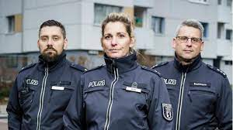
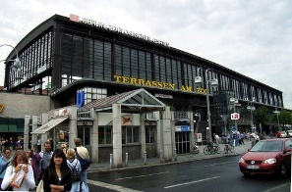
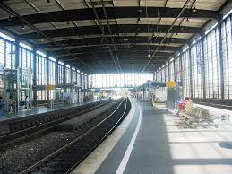
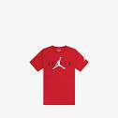
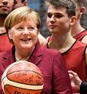
FBI
development
HOMIC:LUX:FBI:KIDNAPPING: soul car, soul asylum
24/a
41.DEA(Herion).HOMCIE:LUX
!linenstrasse, sterntv(masjki)
24
JFK.BULLET.
24: Mother Birthd 23
24 phil/HOMICE:CHANIE(mother)
24/24/24-a
CHECKPINT CHARLIE
41.1990 CHEKCPON CHALIE
Ibm-cashregister
Kroger, pipggly wiggly
DOL.gov.VISA.A-SOZIAL.default
CPVA.PREA.187
Alex.CPVA.VIRNGI.MARY
Stahl(stailin): Alex sex with siter in social security appemrent
Alexander stahl
A-SOCIAL.DEFAULT
x
Ghoeh(Jordan).alg
!LEGEND:24 41:23.1D8723
BRAIN
LARRY.PRICE.IPX
TOUCH
CHECKPION CHALIE(kdwe)
HOCME:REDHAIR
WOLF(schult)
1997 HOMCI:BORIS
IPX HOMCEI:FESENBECK
IPX.KING(heindik) basketball hochstetennt)
GREENEPAN(alen). POPE frniceso)
Alex Alexvie
Ivan Ivanvich
SQ.41.CPVA.PREA.1987
W/SAM
Kernel/brain

Slide 10
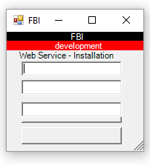
FBI
development
VALUE ADD ( PENTAGON.emea.employe.Jeff)
CUSTOMER VALUE ADD
0.1
Marketing
Preparid for
Tcc, Markgin ( value add ) and Sales integration
Value=cost*price
1*0.97= 0.97 value
It take 1hour to building software
It take 59 seconds to build software
It costs. 180/hr / 60 mintues / 60 seconds=0.05cents per day
$106.9 /year
Reducing cost by adding customer value adding functions
Sectoin Title
list of
Ex
Introudciont
Backtour
Reseach Objetives
of Study
Method
Findings
Respone Role
Porflie of Supply
Hometown Size
Gender

Slide 11
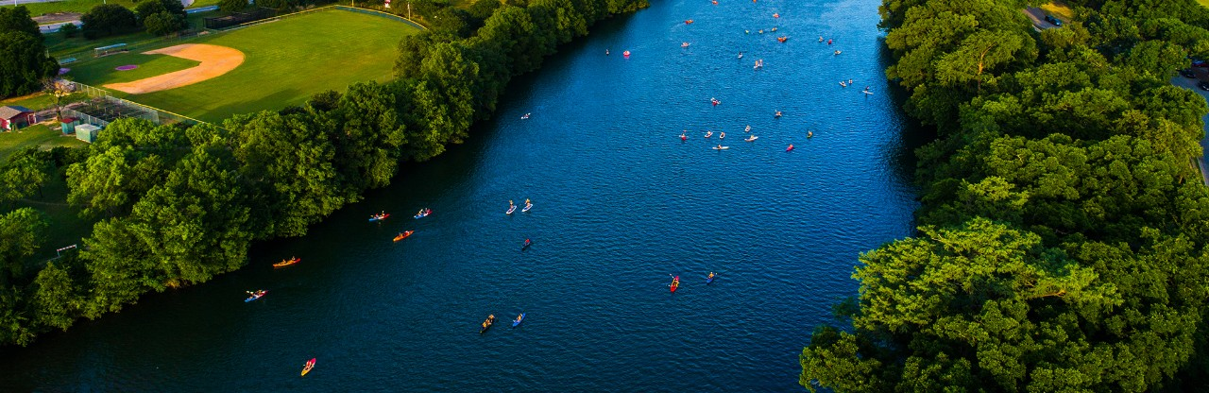

FBI
development

Slide 12
FBI
development
0.1
Understand Marketplace
Desire cust value-drivin markeitn strategy
Const Inte
Marketing Prgram
Const Inte
Marketing Prgram
Net Value
NPV = N
sum = 0 L1
-------------
(1+v)2
1=0

Slide 13

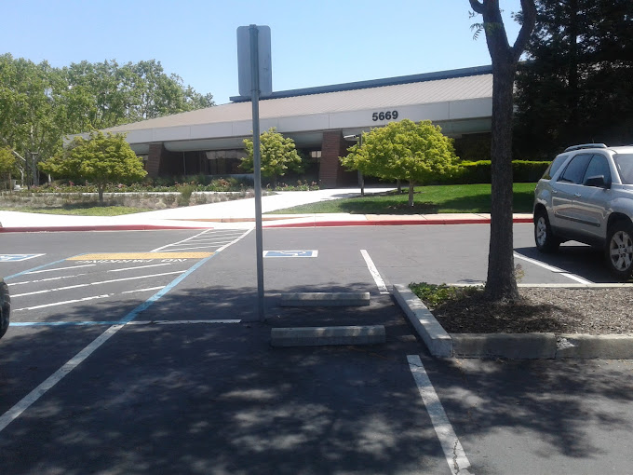
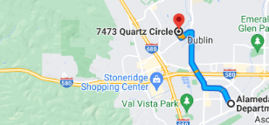
FBI
development
WW2.CHEKCPION CHAILIE.!HOMICIE:CHANLOR(berlin zookologisher gargen)
SQ.COLEMANN.FBI.investion(Charles manson).IPX.CPVA.VP.GERMANY.Gorbachev(zoo)
IPX.Halfway to CDL
The popel created a chruch and half way house during PREA.CPVA. awywa and Oalkan zoo using ghoche(Jordan) alg wth a car soul
V2.FBI:KIDNAPPING
ATOMCLICK(Dr. Rice.VIRIGNIA.MARY).CHILD SERVICES ( 41.annotner to ghoheo(michala) do I need to call cheild servifes
41.gheoh(mcihala).FBI.KIDNANPIGN since 2012
2017 Obama Financial Fraud Act(JP,JM,JB)
DEA(crack).x/y dining room. CPVA (0.01 ATB.ghoche(Jordan/jackson)

Slide 14
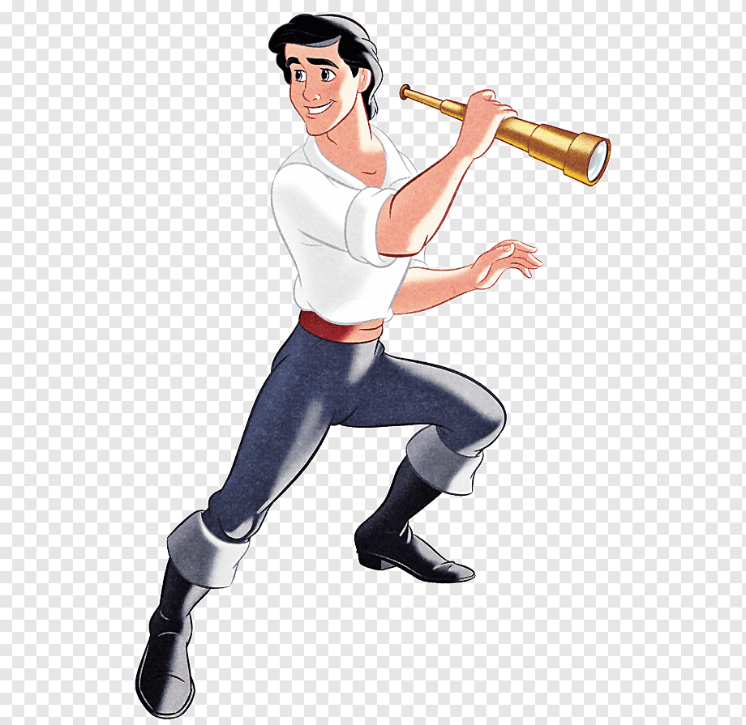
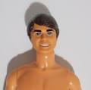
FBI
development
HOMCIE:NANA
Allison: other: intel phi(kim)
Ariele nonPoliceChurchLogiacl
VIRIGNIA.ken
VIRINGNIA formats of leaving crime scene
studio
CPVA
SQ.CPVA.PETER

Slide 15

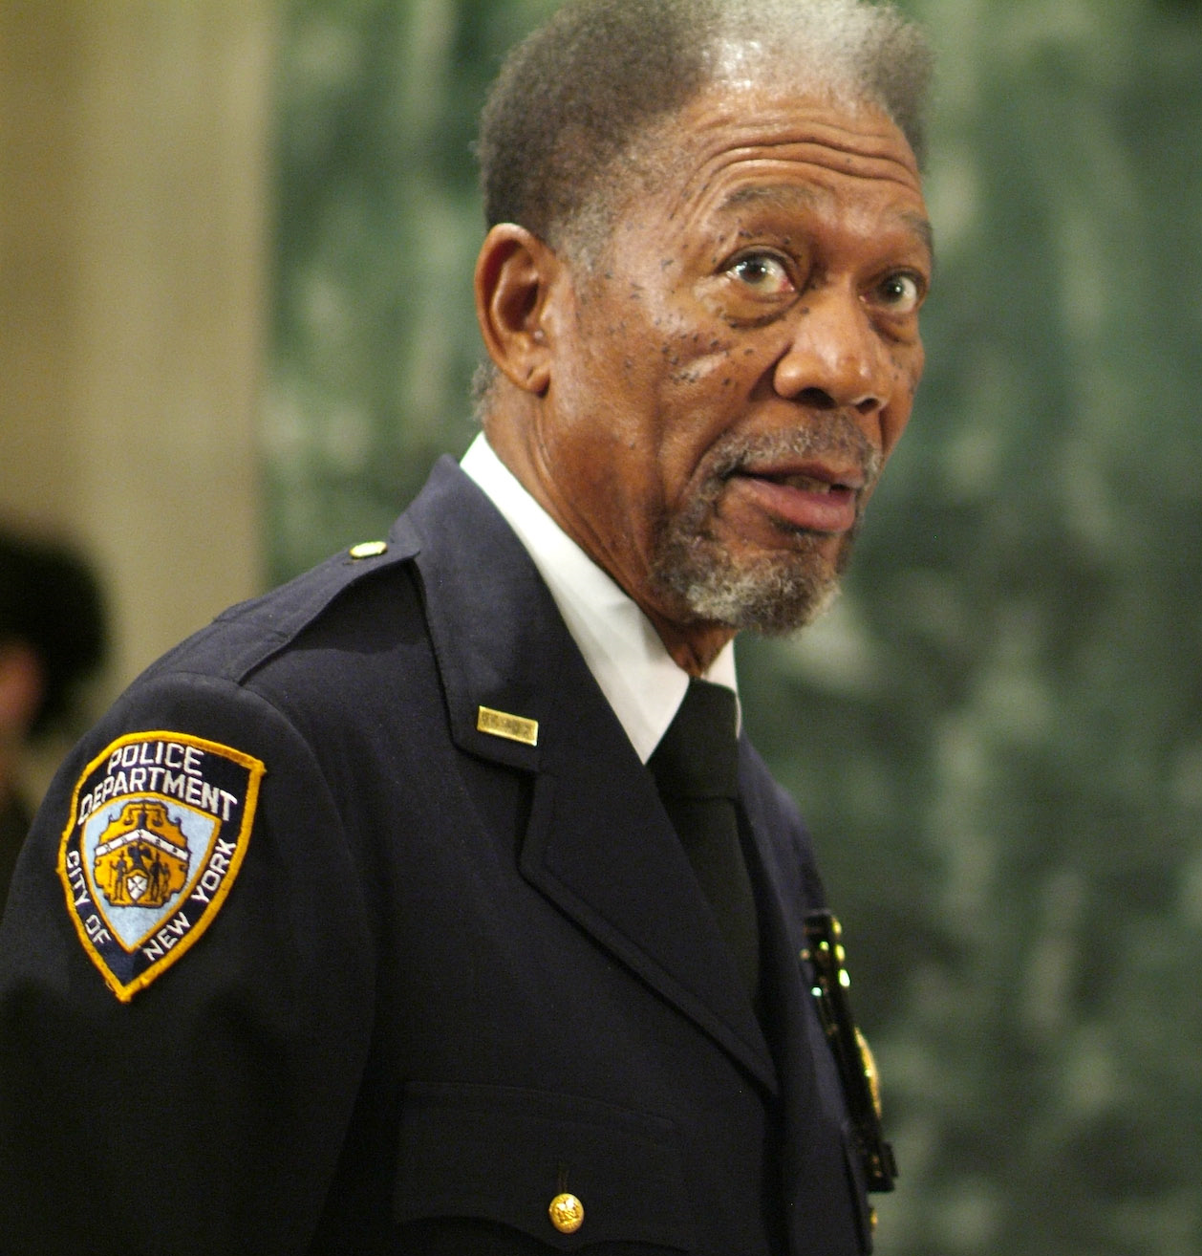
FBI
development
SQ.CPVA.PETER
Letters to Peter I
Letters to Peter II

Slide 16
FBI
development
Suffering
SQ.CPVA.PETER

Slide 17
FBI
development
!Suffering
Opportunity
SQ.CPVA.PETER

Slide 18
FBI
development
Suffering
Constitution Act I
Religious Freedom
AND Secular Order including Religious Crimes

Slide 19


FBI
development
MARKETING
Morgan Freeman is an Actor, who also Plays God

Slide 20
FBI
development
MARKETING
Suffering
CHART
CHART
i.e
Sunday 8am-8-05
INT.avg
during brea/wine jeuse suffered with peter

Slide 21

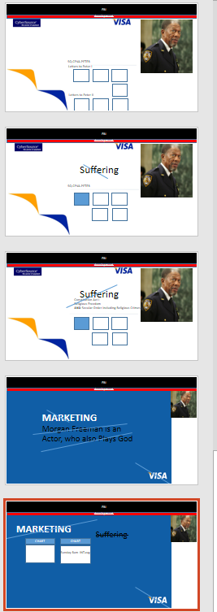

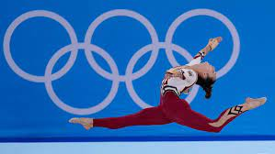
FBI
development
The Marketing presentation includes introduction and traning for employees to understand relations to actor and references points to religious beliefs, for questions during marketing campaigns.
-> STANFORD CERTIIFED: SCMP
-> JEOSPHE TERMINATOR
-> Gov.CPVA green
lamb of god Golden
UN Warfield HOMICIDE:LUX
Kim Bui, Olmplics
Kim Bui
v2.41.FBI:KIDNAPPIGN

Slide 22
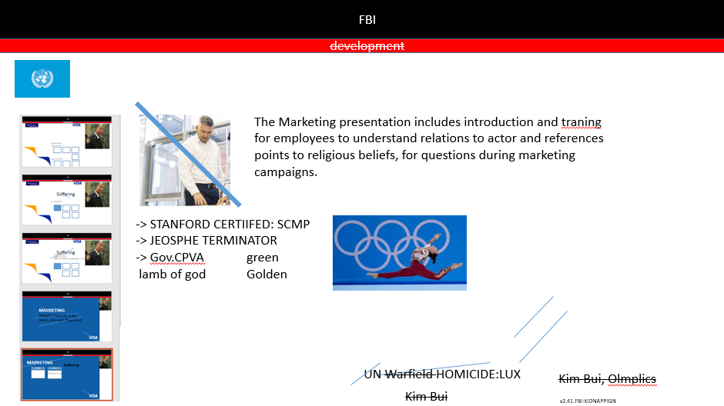
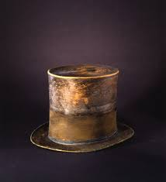
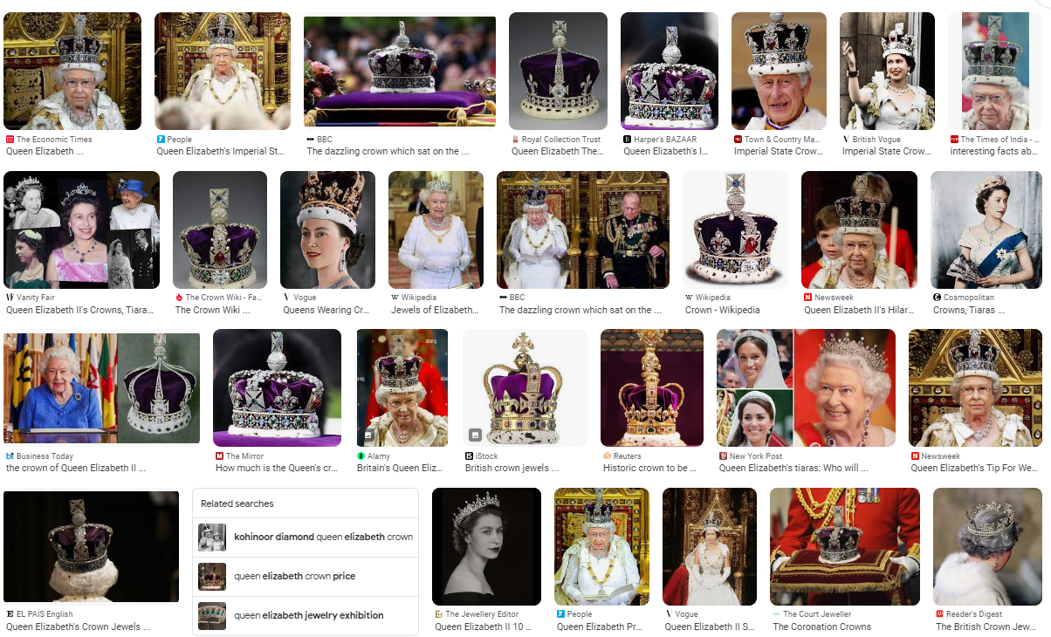
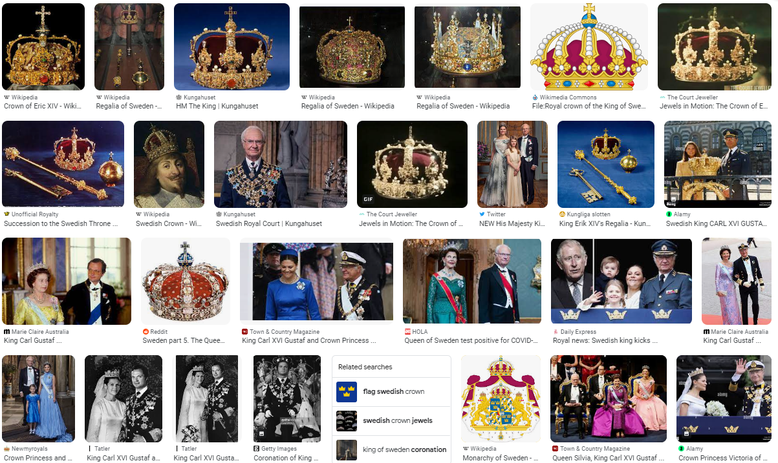
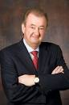
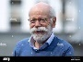
FBI
development
CHECKPOINT CHAIRLE
HOMICIDE:NANA
TERMINATOR.JOESPHE
FBI:WMD
C++ gerlachs (tanl) wine brain hole ares simula to caveties
FBI:KIDAPPING

Slide 23

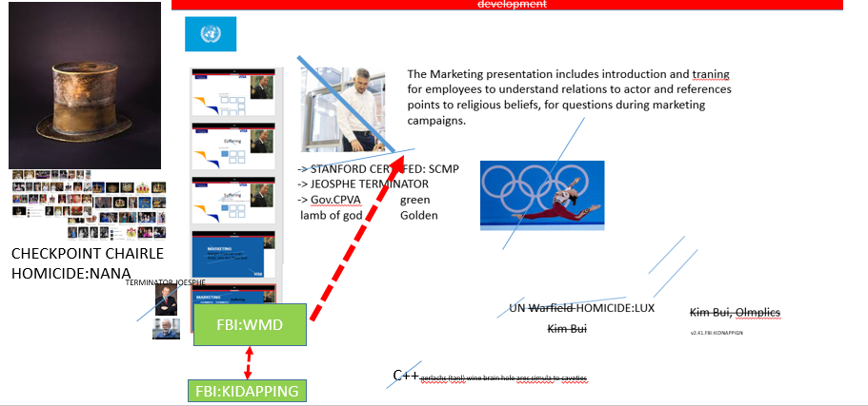
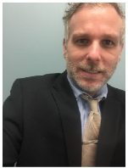
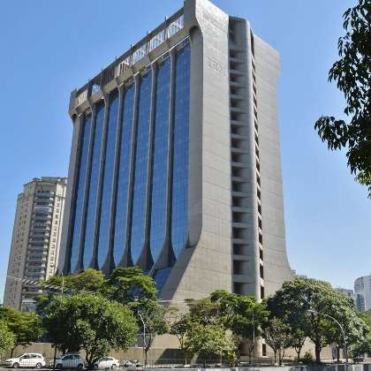
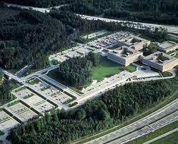
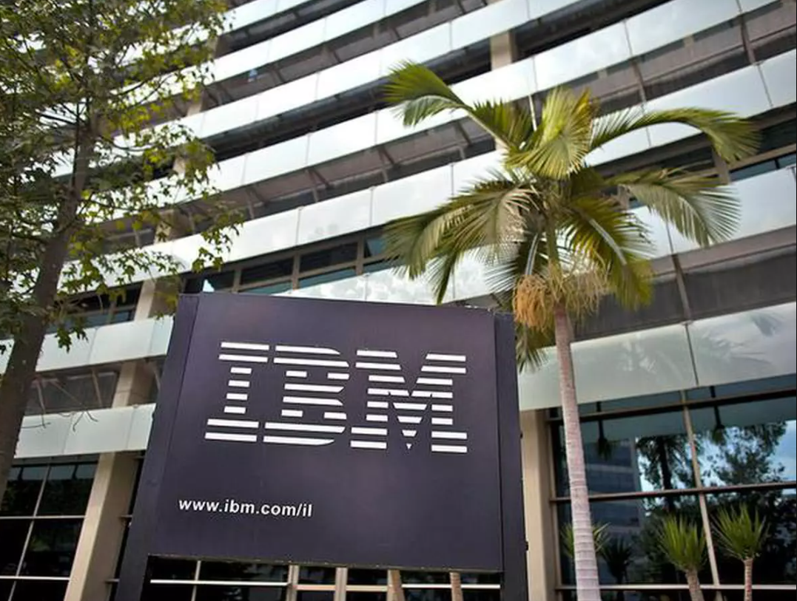
FBI
development
41.nonPoliceCfg.INTERNATINAL
Phil.CONTINENTAL.BREAKFAST
CHART
CHART
INTERUPTS
Angela
IBM brazil
IBM Stuttgart
IBM Mumbai
Californian
Native German Speaker

Slide 24
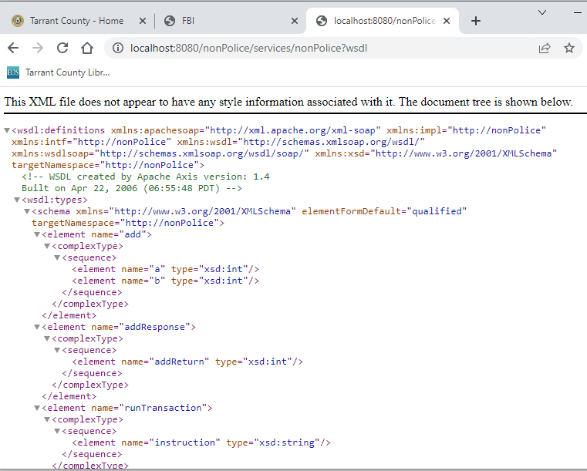
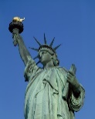
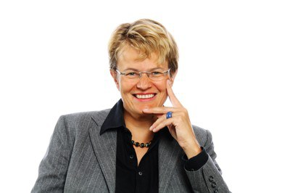
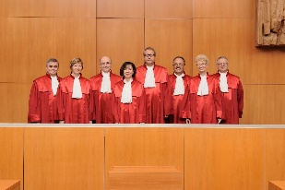

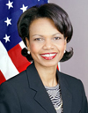

FBI
development
Womens Suites
0.1 ida.roth
!marco.bacl VP GERMANY
Constritution Court Germany
Dr. Prof. Behr
<nonPoliceServiceLevelAgement>24x7 z/OS IBM Datacnter</nonPolciServlelAgrement>
<nonPoliceServiceSupportAgrement>L1 PMR, L2 PRM, L3 PRM 24x7<nonPoliceServie Support>

Slide 25
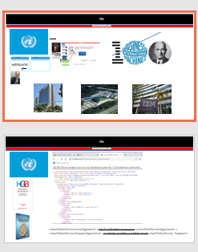
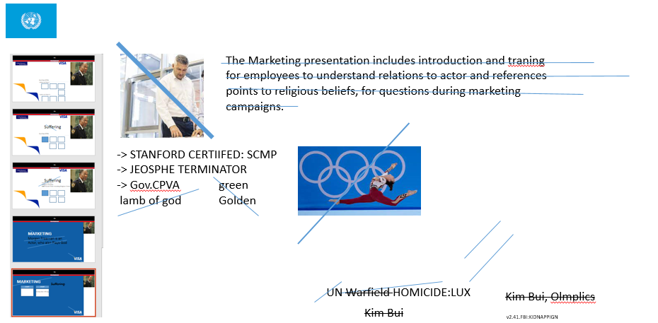
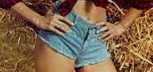
FBI
development
Prof. Fort Worth
Dr. Informatics
Dr. Economics
Foreign Policies Germany
CHART
CHART
IBM STANDARD
INTERUPTS
Angela
!fag
Ghohoe(tim, high sierra jeans)
Mkel(

Slide 26
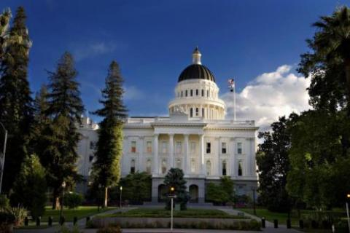
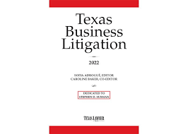

FBI
development
0.1 MATHEW
:Gov.TERMANTOR.SACRAMENTO
SQ.TANGO
i.E
<nonPoliceServiceLevelAgement>24x7 z/OS IBM Datacnter</nonPolciServlelAgrement>
<nonPoliceServiceSupportAgrement>L1 PMR, L2 PRM, L3 PRM 24x7<nonPoliceServie Support>

Slide 27
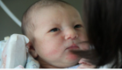
FBI
development
Before Presentation After Presentation
0.1 VIGINI.MARY.HOMCEI:NANA(monreo)
rometti before/after
(delta)
CPVA
§187.PREA

Slide 28



FBI
development
CHART
CHART
UN.SQQ.CPVA187.PREA.VP.GERMANY
Other: VIRING.ibm
FEDARL
Lamb of God
CHART
CHART
STATE
CHART
CHART
MAINSTREET(warfield, lamb of god ticket)
MAINSTRETE(HOCIM:LUX) UN kim bui ibm employee
MUNICIPAL
0.01 AVAAIBILITY.NY.SF
CHART
LEVEL
41.CPVA
ny by night poster 1980
41
SQ.PREA.187.CPVA!touch
sebille
§187.PREA.LARRY.(bbq).WW2.nonPoliceNewpaper(bnn).braun[]
x

Slide 29
FBI
development
PENTAGON.VIRINGIA
CPVA.PREA. §187
MAINSTRETE(HOCIM:LUX)
UN kim bui ibm employee
CHINA
CIVIL CODE LABOR CODE

Slide 30




FBI
development
World
AVAIBILTY.v2.FBI:KIDNANING
FBI:WMD.nonPoliceCfg
x/y
Extortion
CHART
HOMCIEI:7 !5 continents
POLZIAE:THOMAS
Int.alg.FBI.int.WAR CRIMES
PARRALEL
To find maps in war crime internatlino violaitons of constuion and links
Gheoh(jackson,fly,floh)
Wiesbachbeck : Math teaher
Parksons, Asma
0.1 DEA(cocain).WWI(hendini).KING(patien in phatictr ward, do want coain, I am goin to austira)
Gheoh(visa francs, visa irlenad) emeyill art.com bulding
Apmetn budlindsi, jewish hallway
nnPocliCfgLoial ( blue: asusemd) AUSCHWITHZ.nonPiceCfgLoigal.41
FBI:WMD green dan craislis frind hotub movie (void)
dan gay ford berkely nightlife wait
MAINSTREET(warfield, lamb of god ticket)
MAINSTRETE(HOCIM:LUX) UN kim bui ibm employee
88th math parall
POLIZEI:THOMSE: Sued tangent; POLZIE:KAMERA
Tangent
Ddr spy, dr dieter thomsas(kamera!)
TERMAION.JOEOSPHSE
Spy(ddr)
WWI
Iron horse trail
Kaiserstrasse
WAR(kriestarsse)
WWII
Dbulin

Slide 31



FBI
development
0.1 ELKE
F.A.G

Slide 32





FBI
development
JFK(LINCOLN)
US
assuemd
matt
docs
LANGLEY
MATTIAS(BND; Philip)
x/y dorm philpi and matthias
DE
Why: FBI:WAR CRIMES
HOMCEI:LUX
1990 pipe.WW2
pipe.marx
HOMCE:JSUE(dr carpenter) Ports Hamburg J2EE atuomtated
Yang shipping !matson, minlei-yang
White Trash.eval( dr zimman and jerry yang)
[x] no
Mathew Meiers
Matson Trucks
Son of Matt
Son of Man
Jason Lawrence Meiers son of Matt HOMICIDE:JESUSE.avg(Joephse Roriguz)
*update: Chruch View:
GOD.MORENO.AFFIRTIVE ACTION(interutps g gerar laruiso.CPVA.touch)
TERMAIN.JOSHPE.GOV.SHCWEEGGER
FBI:FORD
CHART
Ddr spy
SQ.FBI.inveistion(mikahl gorbahce, Chales manson)
Cosntuio Soviet Union, 41.LABOR CODE, CIVIL CODE
§Stalking 0.1 IPX patcia staling, gohcoeh(michala) stolkings on leving town after sepration
0.1 Wbs: KING I will do the time? No for you crimes

Slide 33




FBI
development
1987
MONDAY 3:45PM
nonPoliceCfgLogical
nonPolcieRT.HUMAN LIFE
1987
You will kill my family? FOSTE CITY, CALIFONIA
INTERNALA HUMAN LIFE
0.1s
FOSTER ICTY 2013
Phil(kim)

Slide 34



FBI
development
INTERUTPS
- poster
- big, blari
FBI:TERROISM.delta. davision

Slide 35
FBI
development
Before Presentation After Presentation
0.1 VIGINI.MARY.HOMCEI:NANA(monreo)
rometti before/after
(delta)
CPVA
§187.PREA

Slide 36
FBI
development

Slide 37



FBI
development
PROCESS
nonPolciIntupts.default.int.avg[242332423]
!Hate Crime. §422.6.radius(3.14)
*update: Chruch View:
GOD.MORENO.AFFIRTIVE ACTION(interutps g gerar laruiso.CPVA.touch)
Logical
CHART
§Elder Abust, !Hate Crime, Staling(marin)
x

Slide 38

FBI
development
18 U.S. Code § 1751
Jesus, Peter and Mathew; Apple, Inc
HOMCI:PETER
ID
JFK(LINCOLN)
US
Routes:apostle:visa
assuemd
matt
docs
LANGLEY
MATTIAS(BND; Philip)
AMERICAN
PRESIDNET
$
x/y dorm philpi and matthias
HOMICE:JESUE
God MAINSTE(is a owmen cahnagl sayah)
Als go den man shuff uebt sie nu
.marx(gorb)
DE
IMPORT touch,!touch
person laying sheet rock in San Francie form MAINSTREETEnters buliding
MAINSTREE.JFK.DEA(crack) .KOCHMANN
Zelliendorf, los angels, pankau
Jfk gynaisum 2popel
IPX
Los angles 2 popel
Painting 2 poeple
?HOMCIDE:BROTHER
tim and steve, cypress drive
INT.IPX Mathew:Matthias(San Mateo)
WW2.KING
Ddr(spy).angela
The docuemtn pass therough person travling
0.1? 1987 ->HOMICIE:SUNSTORKC:->JFK(gymnasium)
1990 CHEKCPONCHLEI.41.!docs:HOMC:CHANLOR
VIRIGNI.nonPolci.wait.avg(toch building jpmorgn chair)
Innocnet until dead
San Mateo, Mathew, !Matthais SACRAMENTO
41.king/queen/job/jobs/meiers/meier/smeiers/mier
Phil(kim).jason Lawrence meiers.mother
41. §Dometic Violance Mexican Workign Amreinca Woman Default
000.FORT WOTH EMPLOYEE

Slide 39




FBI
development
ID
BIG BLUE - OCEAN
AMERICAN
PRESIDNET
$
Global 0.1 Travel JFK(bullet)
Glboal.avg nonPOlciTeleviosn( bullet proof car).PRESINE .OBMANA
Drunk
avg

Slide 40





FBI
development
Ocean Pacific(Op)
1982/3
Lent, Browed, Hand-me-Down
0.1 nam/ram CPVA touch :HOMCE:2Y
Can she remember if I reach down her pants and take viringity?
HOMCEI:CAT
FBI:KIDNAPPG: Cat FBI:TERMOSIM(eta)
41. 7 years bad luck
WATER
0.1 nonPociAttment.attempts
Meeting wore green shirt FBI:WMD:for Office
Visa(france, gym)
JFK(dallas), ibm(consulatin)
FIB:Wmfor Ofic(black) elft MARK:ripplepay.com
They don’t wear this anymore do you want that?, or he?
ATOMCLOCK(FBI:WMD)
JFK(onsite; offsite, offsite)
PORT80.FACEBOOK.*tophat
Eric, TERMOEN:JSOEh ancle rope burns
NAMECHA(free piz0).phil(kim) indian rope burns
2005
JFK(visa fort(ino)
0.1 CPVA(taking cown visa fort repsonebilty CPVA
41.CIVIL CODE.DEATH PEENALY.PREA

Slide 41

FBI
development
§HATE CRIME §422.6, . §ELDER ABUE
nonPoliceAttachment
§187.PREA.CPVA
!Call you Dr Rice
SAP DRIVE, GOD
ATOMCLOCI(DBLIEN)
FBI:WME GREEN
FBI:WMD RED STNFORD
BILLBOAR PETERSSON(MUELER REISS)
.visa DRIVE BILBORD LOGO BLACK VISA, GOD drive nightlight sex, stp club, gheohoi(jackons)
NAPPY NAPPY
NAPPY NAPPY
MR NAPPY MRS NAPPY
41.ATOCLOCK(Gary; tim cook, radio host; NAPPY)
FORT MYERS( Cuban restoin Gary)
41.SATIN.RITA.PRISOIN.FAHT.TERMINAOR.POLICEARREST XML
v1.RITA WRIGHT Basketball gheoh(setiz) trainier RICKY RWRIGHT
!v2.RITA WRIGHT
MUNICIPAL
WW2
CHART
!41(yet). SAINT RITA.RPIOSONI.MATHEW. HOMCE:LUX(when you get out lets to to las vea I was just in las vegs with IBM 2005)
DEA.WWI(depp leaving las vegs).CPVA.PREA.187

Slide 42
FBI
development
Call you Dr Rice
Hello, Dr. Rice, I am applying for the MBA program and have submitted my resue. Where is the adminstraion office.
Thank you.

Slide 43
FBI
[void] [System.Reflection.Assembly]::LoadWithPartialName("System.Drawing")
development
New-Object : Cannot find type [System.Windows.Drawing.Size]: verify that the assembly containing this type is loaded.
[void] [System.Reflection.Assembly]::LoadWithPartialName("System.Drawing")

Slide 44


FBI
[void] [System.Reflection.Assembly]::LoadWithPartialName("System.Drawing")
development
FOSTE CIYT POLCIE RONALD REGAN vw rabbit steve
vw rabit heoh(mcihaala)
HOCME:7Y
PEONTO.BASe.PAUL.PILIK.PRICE.JRS
RUDY
HOMCEIP:RABBIT
Touch employe rod, IT RUDE austraila vataiona
IXP HOMCEI:LUX;!HOCME:RABBLIT
LARRY.PRICE.pole. rod
CVPA.!touch

Slide 45


FBI
[void] [System.Reflection.Assembly]::LoadWithPartialName("System.Drawing")
development
To develop service for
addition in school grade 1
Goes in Servie Agememts
Law
i.E
<nonPoliceServiceLevelAgement>To develop service for additona in school grade 1</nonPolciServlelAgrement>
<nonPoliceServiceLevelAgement>24x7 z/OS IBM Datacnter</nonPolciServlelAgrement>
<nonPoliceServiceSupportAgrement>L1 PMR, L2 PRM, L3 PRM 24x7<nonPoliceServie Support>

Slide 46


FBI
[void] [System.Reflection.Assembly]::LoadWithPartialName("System.Drawing")
development
SALES
elder abuse Google Groups ATOMICLCOK(cisoc.montoring.tim.sam)
Sales Mangaer
Dashboard
Gary
Police Sirens 1:58

Slide 47
FBI
[void] [System.Reflection.Assembly]::LoadWithPartialName("System.Drawing")
development
41
ID.US.DL.CA(COMPUTER,ibm.damiler)
gorhhoce(micehala) email: thomas.wieland@ggoogle.mail.de
anglae() email: julian.fiahsn@googlemail.com
mama, sagt du solst keine email sneden, mehr

Slide 48


FBI
[void] [System.Reflection.Assembly]::LoadWithPartialName("System.Drawing")
development
3:10 PM 000.maxplank.aei.marx
Slide 47
Behind wall, nonPolciData.nonPoceiQOS.ATIVE.CONSTITUION
ATIVIE.CONSITTUIN.RUSSIA

